Slide 1
Chapter 13-Modem

Slide 2
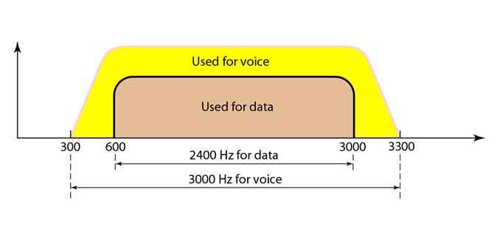
Introduction
Traditional telephone lines can carry frequencies between 300 and 3300 Hz, giving them a bandwidth of 3000 Hz. All this range is used for transmitting voice, where a great deal of interference and distortion can be accepted without loss of intelligibility.

Slide 3
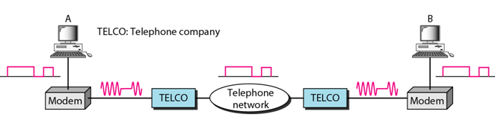
Cont.
The term modem is a composite word that refers to the two functional entities that make up the device: a signal modulator and a signal demodulator.
A modulator creates a bandpass analog signal from binary data.
A demodulator recovers the binary data from the modulated signal.

Slide 4
Cont.
The computer on the left sends a digital signal to the modulator portion of the modem; the data are sent as an analog signal on the telephone lines.
The modem on the right receives the analog signal, demodulates it through its demodulator, and delivers data to the computer on the right.
The communication can be bidirectional, which means the computer on the right can simultaneously send data to the computer on the left, using the same modulation/demodulation processes.

Slide 5
Uploading and downloading in 56K modems
Traditional modems have a data rate limitation of 33.6 kbps, as determined by the Shannon capacity.
Example
Let’s calculate the theoretical highest bit rate of a regular telephone line. A telephone line normally has a bandwidth of 3000. The signal-to-noise ratio is usually 3162. What is the channel capacity?
Solution

Slide 6
Cont.
This means that the highest bit rate for a telephone line is 34.860 kbps.
If we want to send data faster than this, we can either increase the bandwidth of the line or improve the signal-to-noise ratio.
However, V.90 modems with a bit rate of 56,000 bps are available; these are called 56K modems. These modems may be used only if one party is using digital signalling (such as through an Internet provider).
They are asymmetric in that the downloading rate (flow of data from the Internet service provider to the PC) is a maximum of 56 kbps, while the uploading rate (flow of data from the PC to the Internet provider) can be a maximum of 33.6 kbps.

Slide 7
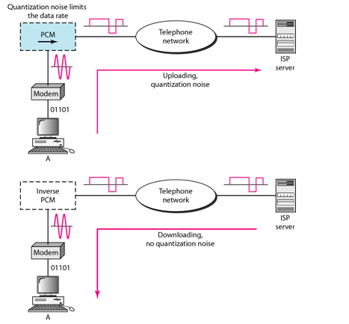
Cont.

Slide 8
Do these modems violate the Shannon capacity principle? (Explain the asymmetry of 56K modems. )
No, in the downstream direction, the SNR ratio is higher because there is no quantization error.
In uploading, the analog signal must still be sampled at the switching station. In this direction, quantization noise is introduced into the signal, which reduces the SNR ratio and limits the rate to 33.6 kbps.
However, there is no sampling in the downloading.
The signal is not affected by quantization noise and not subject to the Shannon capacity limitation. The maximum data rate in the uploading direction is still 33.6 kbps, but the data rate in the downloading direction is now 56 kbps.

Slide 9
Cont.
One may wonder how we arrive at the 56-kbps figure. The telephone companies sample 8000 times per second with 8 bits per sample. One of the bits in each sample is used for control purposes, which means each sample is 7 bits. The rate is therefore 8000 x 7, or 56,000 bps or 56 kbps.

